Slide 1
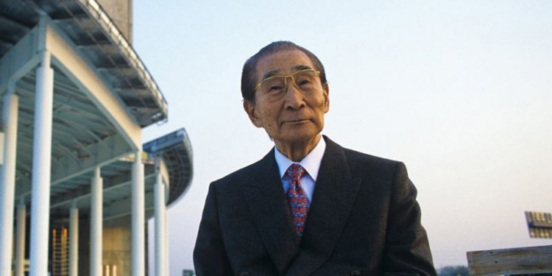
Kenzō Tange

Slide 2
Japanese architect
4 September 1913 – 22 March 2005
blended Japanese architecture with Le Corbusier style concrete modernism FUSION
designed major buildings on five continents.
design philosophy Japanese, Tange’s ideas aligned with modern architecture from the west in many ways –
simplicity,
lightness,
openness,
modulated repetition and
ingenuous construction with naked
materials.

Slide 3
Tange spent his early life in the Chinese cities of Hankow and Shanghai; he and his family returned to Japan after learning of the death of one of his uncles. In contrast to the green lawns and red bricks in their Shanghai abode, the Tange family took up residence in a thatched roof farmhouse in Imabari on the island of Shikoku
After finishing middle school, Tange moved to Hiroshima in 1930 to attend high school. It was here that he first encountered the works of Swiss modernist, Le Corbusier. His discovery of the drawings of the Palace of the Soviets in a foreign art journal convinced him to become an architect.

Slide 4
Although he graduated from high school, Tange's poor results in mathematics and physics meant that he had to pass entrance exams to qualify for admission to the prestigious universities. He spent two years doing so and during that time, he read extensively about western philosophy. Tange also enrolled in the film division at Nihon Universitys art department to dodge Japan's drafting of young men to its military and seldom attended classes
In 1935 Tange began the tertiary studies he desired at University of Tokyo's architecture department. He studied under Hideto Kishida and Shozo Uchida. Although Tange was fascinated by the photographs of Katsura villathat sat on Kishida's desk, his work was inspired by Le Corbusier. His graduation project was a seventeen-hectare (42-acre) development set in Tokyo's Hibiya Par

Slide 5
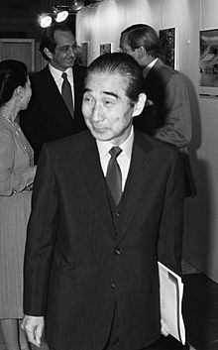
When the Second World War started, he left Maekawa to rejoin the University of Tokyo as a postgraduate student
Tange's interest in urban studies put him in a good position to handle post war reconstruction. In the summer of 1946 he was invited by the War Damage Rehabilitation Board to put forward a proposal for certain war damaged cities; he submitted plans for Hiroshima and Maebashi.

Slide 6
Six golden rules
There are six rules an architect must follow according to Tange:
Simplicity in plan and form. Unnecessary undulations and geometrical shapes are not required.
Typification. One must interpret technical and engineering solutions through the eyes of an artist before implementation.
Strength. Architecture should insist, it should be bold rather than weak.
Ornament. This is useful when it holds - a symbolic meaning and -can be understood by most people.
Honesty to materials. Why hide it behind gypsum wall boards and ceilings if the original craftsmanship is beautiful?
Elimination of Furyu. Eliminate the meaningless prettiness. Let’s not spend 56 hours carving that wooden door.

Slide 7
According to Tange “influence on people’s lives”, is the most important and fascinating problem of his art.
To reduce these problems is to reduce architecture to a purely aesthetic task, the object being to create something pleasing to the eyes of the people one wants to please;
in other words, to create beauty – a relative, visual beauty with no ultimate meaning”. – Robin Boyd from Kenzo Tange – Makers of Contemporary Architecture

Slide 8
He felt every project was a springboard to the next.. Advancing to the future from the past
He played a important role in the country’s reconstruction after world war 2
Influenced by Japanese styles.. Followed Le Corbusier and Michelangelo.
In 1960s ,the buildings he continued to plan were a part of spatial context concerned with great metropolitan areas.
Expressing a changeover from mere functionalism to structuralism.

Slide 9
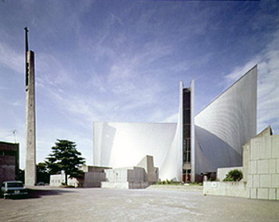
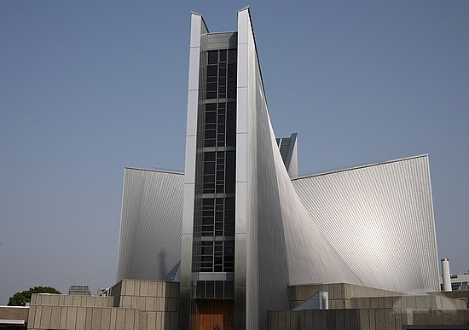
ST.MARY’S CATHEDRAL,TOKYO
Humanity and spiritual aspects

Slide 10
St. Mary Cathedral — Tokyo, Japan (1964)
there are some buildings that do not belong to any time or age. The Saint Mary Cathedral of Tokyo by Kenzo Tange is definitely one of these.”
Replacing the Gothic wooden cathedral that burnt down during the war, the elegant concrete building draws inspiration from the lightness of a bird, and its wings.

Slide 11
St. Mary’s Cathedral is three-storied building made from reinforced concrete.
The exterior surfaces are clad in stainless steel, which gives them a special radiance in keeping with the religious character of the building. The characteristic roof is structured with hyperbolic paraboloid shells and it is combined from the wall to the roof.
The plan of the building is in the form of a cross, from which eight hyperbolic parabolas rise up. These open upwards to form a cross of light which continues vertically the length of the four facades.
The slits are arranged between the two Hyperbolic Paraboloid shells for the glass window. Descriptions Site Area: 15 098 m² Gross Floor space: 3 650 m² Shell Height: 39.42 m Tower Height: 61.68 m Floors: 1 aboveground 1 underground Construction System: Concrete

Slide 12
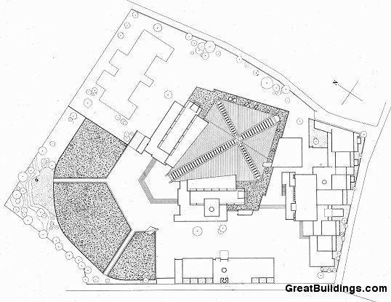

Slide 13
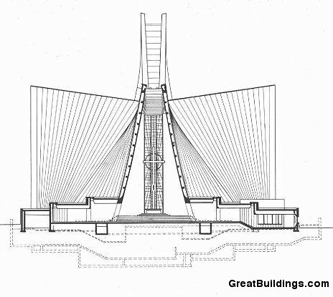

Slide 14
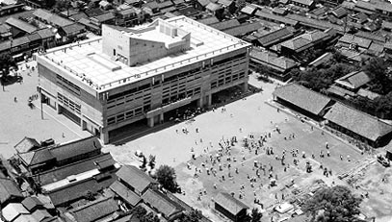
Imabari City Hall Complex — Imabari, Japan (1958)
Designed for his hometown, this civic complex showcases Tange’s increasing skill at manipulating the expressive possibilities of exposed concrete.
Fascinated by communal spaces, Tange wrote that it is the place in a city where a “citizen moves from the private realm to establish connections with society.”

Slide 15
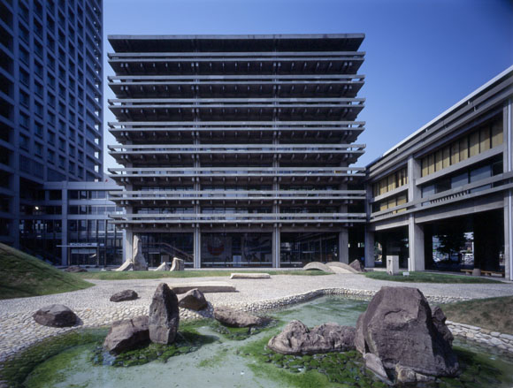
Kagawa Prefectural Government Office — Kagawa, Japan (1958)
Finding the perfect balance between tradition and modernism, this is considered one of the most important work’s in architecture’s history and has served as a model for government buildings since WWII.

Slide 16
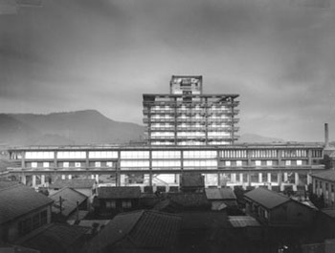

Slide 17
HIROSHIMA PEACE MEMORIAL
· Kenzo Tange was commissioned with the challenge of designing the reconstruction of Hiroshima.
· The most traditional structure that Tange ever designed.
· TANGE Kenzo didn't incorporate any direct element that would be directly associated with Japan. He referred to Le Corbusier and adopted the international style which did not belong anywhere but was universal for all human beings.
· "The building is raised up on pillars, like Le Corbusier’s patented piloti.
· Furthermore, the building is articulated with reinforced concrete, a natural convention of Corbusier. The complex as a whole has a monumental quality.
· The monument...in the form of a hyperbolic parabola, brings together modern tendencies and techniques and the ancient form of the Haniwa, the traditional tombs of the rulers of old Japan."
· Tange loved what Le Corbusier represented and was convinced that Japanese architecture would become enormous in scale, pursuing that large architecture built in social human scale was in demand.
· The museum is raised by piloti, enabling you to see the A-bomb Dome through it. The piloti, excellent in its aesthetic design, plays its practical role as well: the axis on the ground runs straight without obstruction. No other piloti would have such a clear-cut and important role.

Slide 18
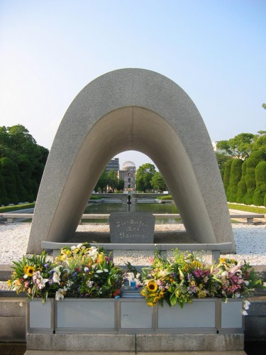
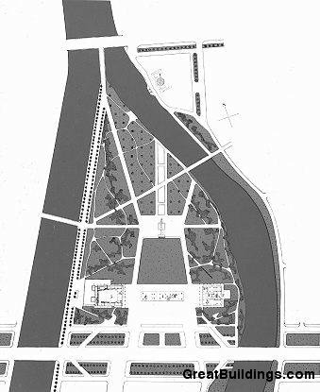

Slide 19
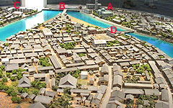
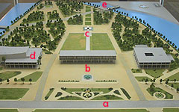
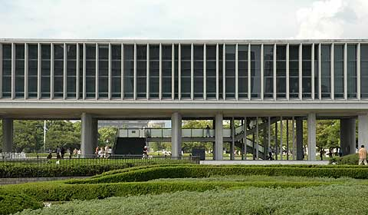

Slide 20
Olympic arena stadium
Together with a number of other important projects which Kenzo Tange carried out after 1959, the Olympic stadia in Tokyo can be regarded as the culmination of his career, on a par with the highest achievements of the Japanese tradition...
The plan [of the larger stadium] is in the form of two semi-circles, slightly displaced in relation to one another, with their unconnecting ends elongated into points.
The entrances are located in the concave sides
. The roof is supported on two reinforced concrete pillars, and is made up of a system of steel cables onto which enameled steel plates are then soldered. The curving form of the roof serves to make it more resistant to wind, which can reach hurricane force in this region.

Slide 21
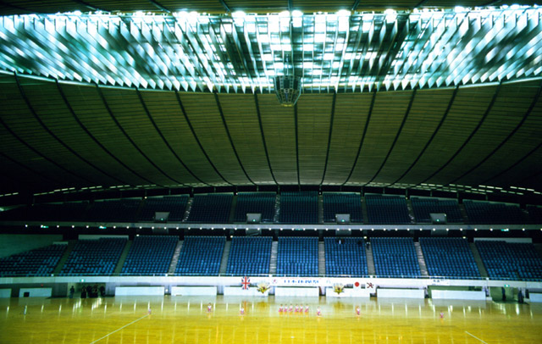

Slide 22
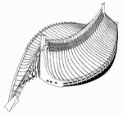
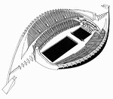
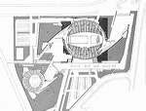
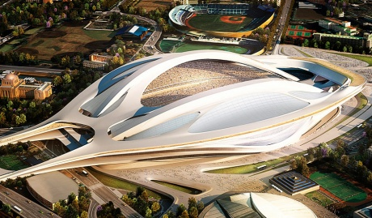

Slide 23
The Unlikely Story of How a Japanese Architect Designed Assad's Palace
One report described a massive room clad in marble tiles that each cost almost $150 a piece in today’s dollars. In total, the price of the room’s tiling amounted to nearly $3.4 million dollars, adjusted for inflation. There were soaring fountains and cavernous marble rooms. It was a cold and intimidating fortress, empty except for scurrying aides. the Assad family has never actually lived in the building, much state business is conducted there.
What’s more interesting than the building’s opulence, though, is the role of the architect who built it. Tange had been lauded for his Hiroshima memorial, built three decades prior, and for his critical role in the rebuilding of Tokyo after World War II. When Hafez al-Assad commissioned the building from him in 1985, his human rights violations were already well-known. Though Tange seemingly never spoke publicly about the process of accepting and designing the palace, it’s easy to imagine the moral ambiguity of the situation: Should architects judge their clients based on their morals?

Slide 24
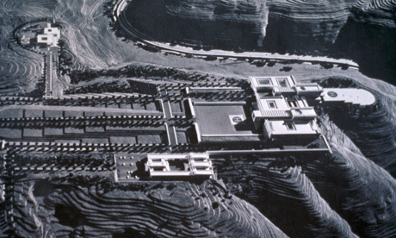
Kenzo Tange’s Syrian Palace Languishes as an Empty Monument of Dictator Design

Slide 25
Tange had the wherewithal to withdraw from the project before construction began on the palace, but his timely departure does not nullify his moral complicity in repressive dictatorship. The sad take-away from this revelation is how far minimalism, now a style of choice among the wealthy and corrupt (totalitarian governments and corporate interests alike) has fallen from the revolutionary, utopian ideals of its founders.
It's hard to say how Tange would’ve felt about his role in creating the Assad regime’s architectural presence in Damascus. But it’s safe to say that as a champion of modernist ideals and peace, the cognitive dissonance was strong.

Slide 26
Thank you
ANU KRITHIKA
HARSHINI M

